Slide 1
Lecture 3: Introduction to Flip-Flops and Finite State Machines
To watch lecture video click link below
Lecture 3a video
To view slides, continue to next slide

Slide 2
Lecture 3: Introduction to Flip-Flops and Finite State Machines
Credit for un-cited Figures used in this Lecture:
Null and Lobur, The Essentials of Computer Organization and Architecture, 2e

Slide 3
Lecture 3a: Introduction to Flip-Flops
picture credit: eroswholesale.com

Slide 4
Overview
Digital Logic
Combinational Circuits
Sequential Circuits
Combinational Circuits (A Quick Review)
Sequential Circuits
Clocks
Flip-Flops
Finite State Machines (Lecture 3b)

Slide 5
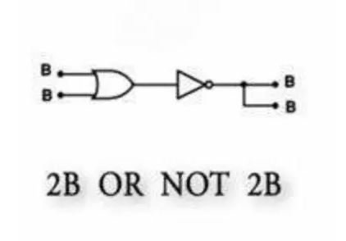
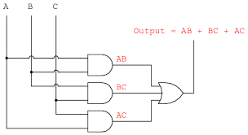
Combinational Circuits: A Quick Review
Figure credit: unknown source.

Slide 6
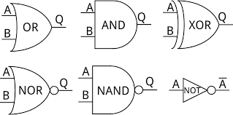
Commonly Used Gates

Slide 7
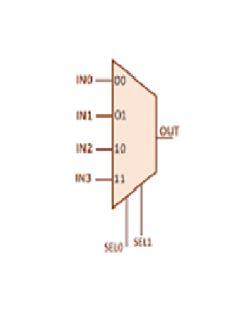
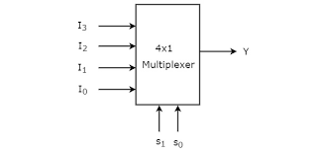
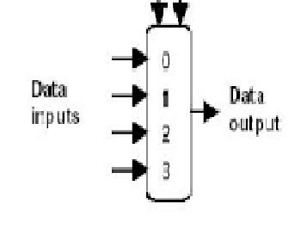
Multiplexor
Input: 2^{n}
Output: 1
Control: n bits
Example: 4 x 1 Mux
Note: Our textbook uses the 3rd notation.

Slide 8
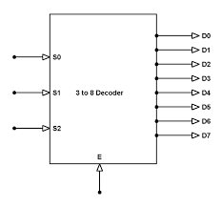
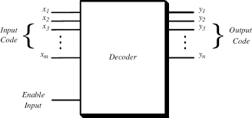
Decoder
Input: n bits
Output: 2^{n} bits (only 1 bit is 1 all other bits 0)

Slide 9
Sequential Circuits
A sequential circuit defines its output as a function of both its current input and its previous inputs.
The output depends on past inputs!
(Compare: combinational circuits only depend on current inputs.)
Also called storage elements (i.e. a sequential circuit has memory!)

Slide 10

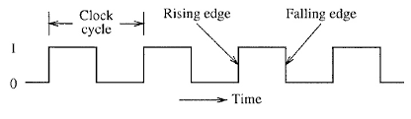
Clocks
Clock Frequency or clock rate/speed: the number of cycles per second, e.g. 1MHz, 4GHz

Slide 11
Flip-Flops
A circuit that is allowed to change state whenever the clock signal triggers
Latch vs. Flip-Flops
Latch: level triggered
Flip-Flops: edge triggered
Note: here we do not distinguish Latch and Flip-Flops. We use Flip-Flop as a general term.

Slide 12
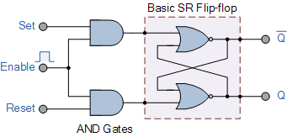
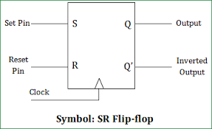
SR Flip-Flop (SR: Set/Reset)

Slide 13
Truth Table
S | R | Q(t) | Q(t+1)
0 | 0 | 0 | 0
0 | 0 | 1 | 1
0 | 1 | 0 | 0
0 | 1 | 1 | 0
1 | 0 | 0 | 1
1 | 0 | 1 | 1
1 | 1 | 0 | undefined
1 | 1 | 1 | undefined
S | R | Q(t+1)
0 | 0 | Q(t) (no change)
0 | 1 | 0 (reset to 0)
1 | 0 | 1 (set to 1)
1 | 1 | undefined
Characteristic table or partial truth table
Complete Truth Table

Slide 14
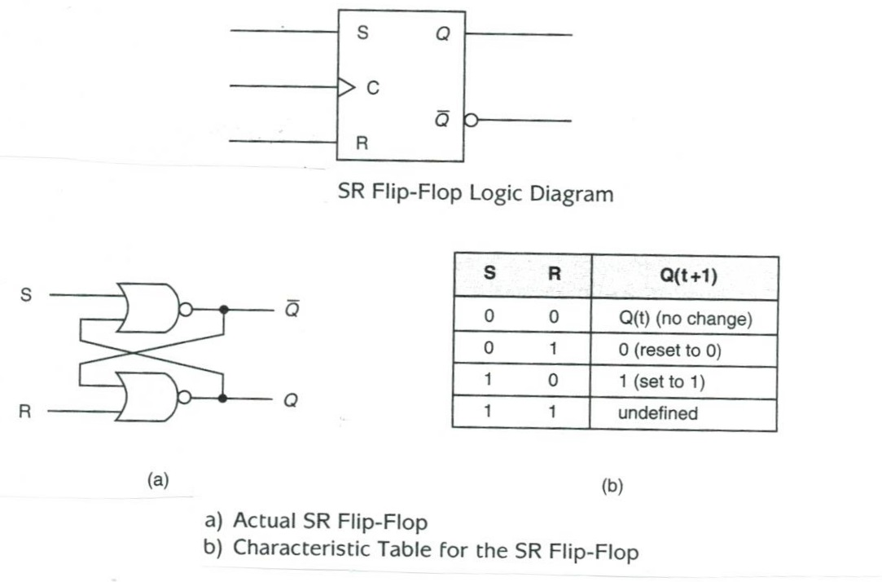
SR Flip-Flop: Summary

Slide 15
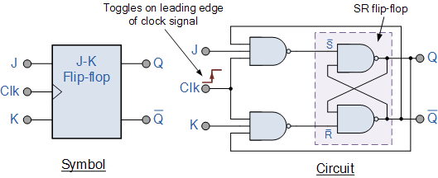
JK Flip-flop
To ensure situations such as undefined states in SR flip-flop will never arises
Named after Texas Instruments engineer Jack Kilby

Slide 16
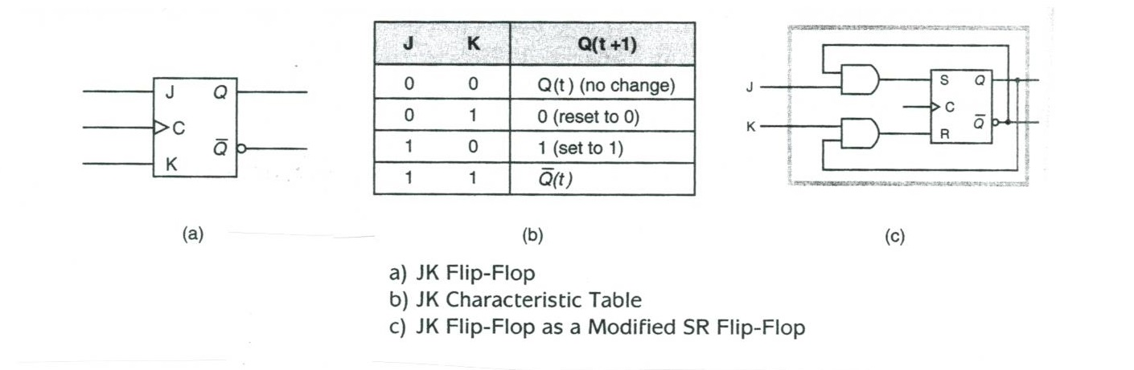
JK Flip-Flop: Summary

Slide 17
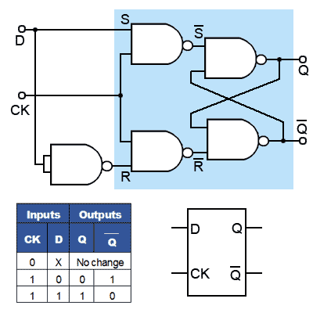
D Flip-flop (D: Data)
D | Q(t+1)
0 | 0
1 | 1
Character Table

Slide 18
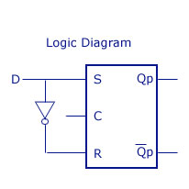
D flip-flop as modified SR flip-flop

Slide 19
Application of D Flip-Flops: Registers
A Register File built with D Flip-Flops. Left: Register read circuits; Right: Register write circuits.

Slide 20
Summary and To-Do List
Differences between combinational circuits and sequential circuits;
Question: how to distinguish combinational and sequential circuits?
The principles and operations (character or truth tables) of three types of flip-flops;
Registers: a popular usage of flip-flops.
To Do
zyBook 8.7 & 8.8

